Slide 1
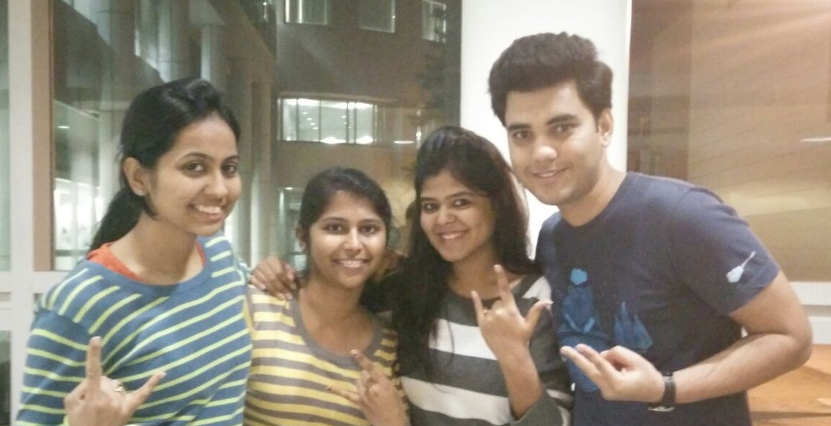
Energy Consumption Optimizer Using IoT – Team18
Team Members Guided By
Neha Khowala Prof. Rakesh Ranjan
Piyush Patil
Rekha Shankar Reddy
Srushti Ekbote

Slide 2
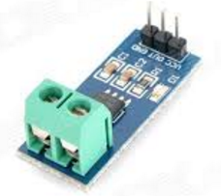
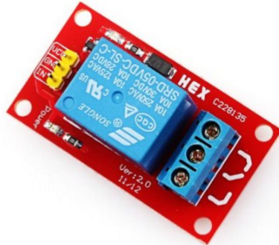
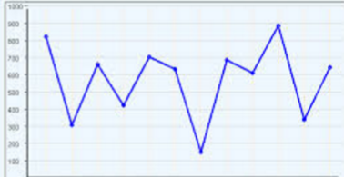


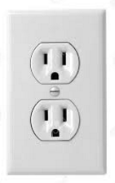
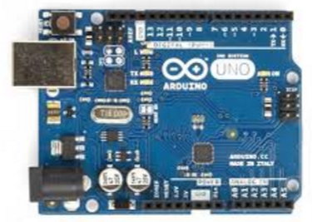
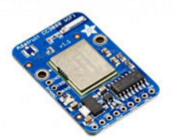
Sequence Flow (with all Components)
Power consumption Statistics
Real-time Power consumption – Current Sensor
5V – One channel Relay Module
Public Cloud
Power Socket
WiFi module – connecting with the Cloud
Arduino receives the POWER values

Slide 3
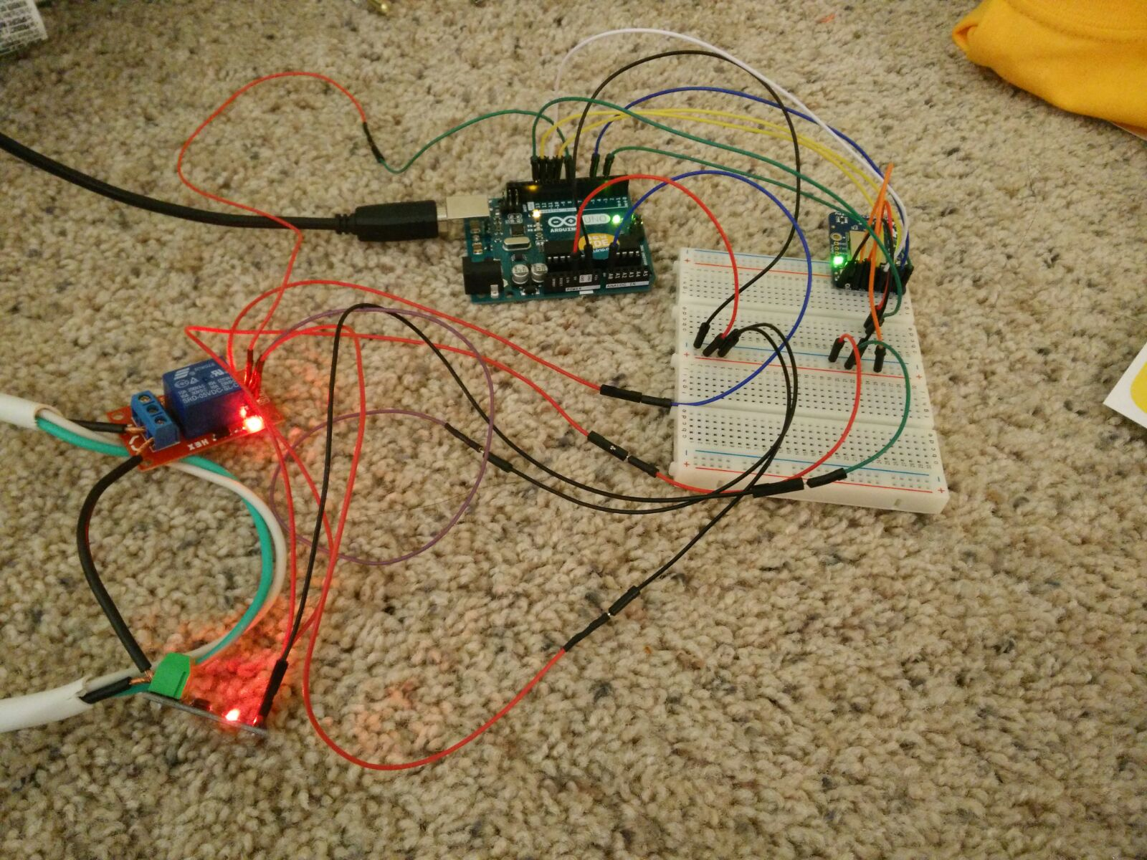
Circuit Diagram

Slide 4
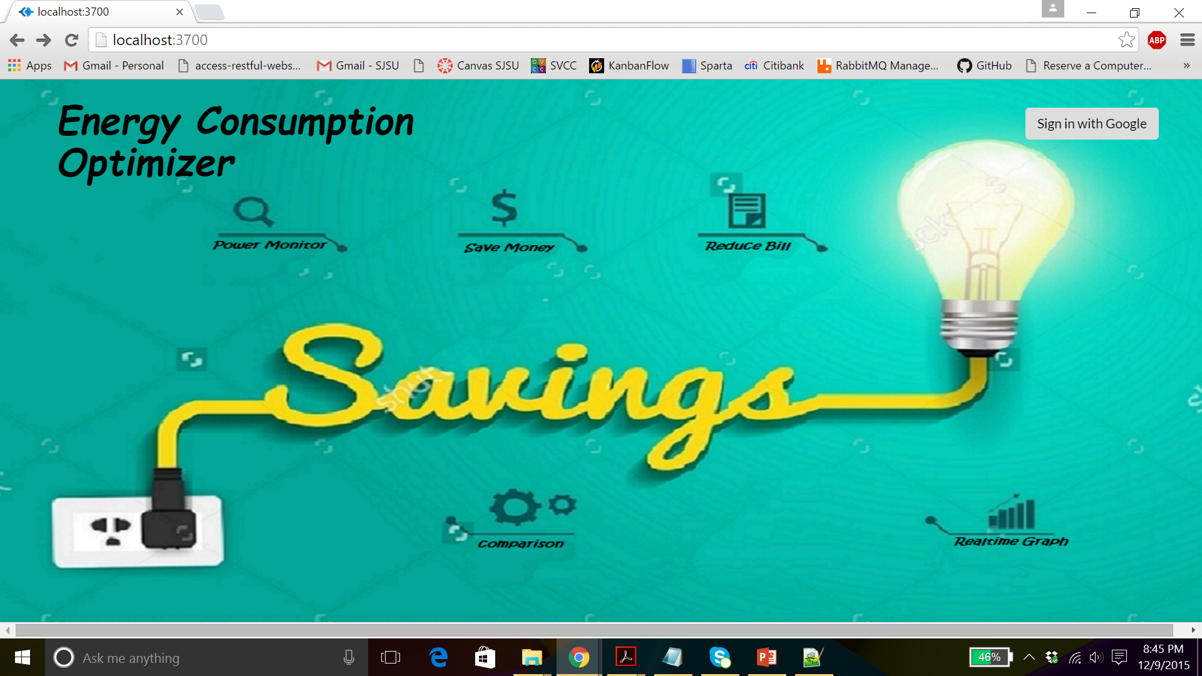
Energy Consumption Optimizer – with OAuth

Slide 5
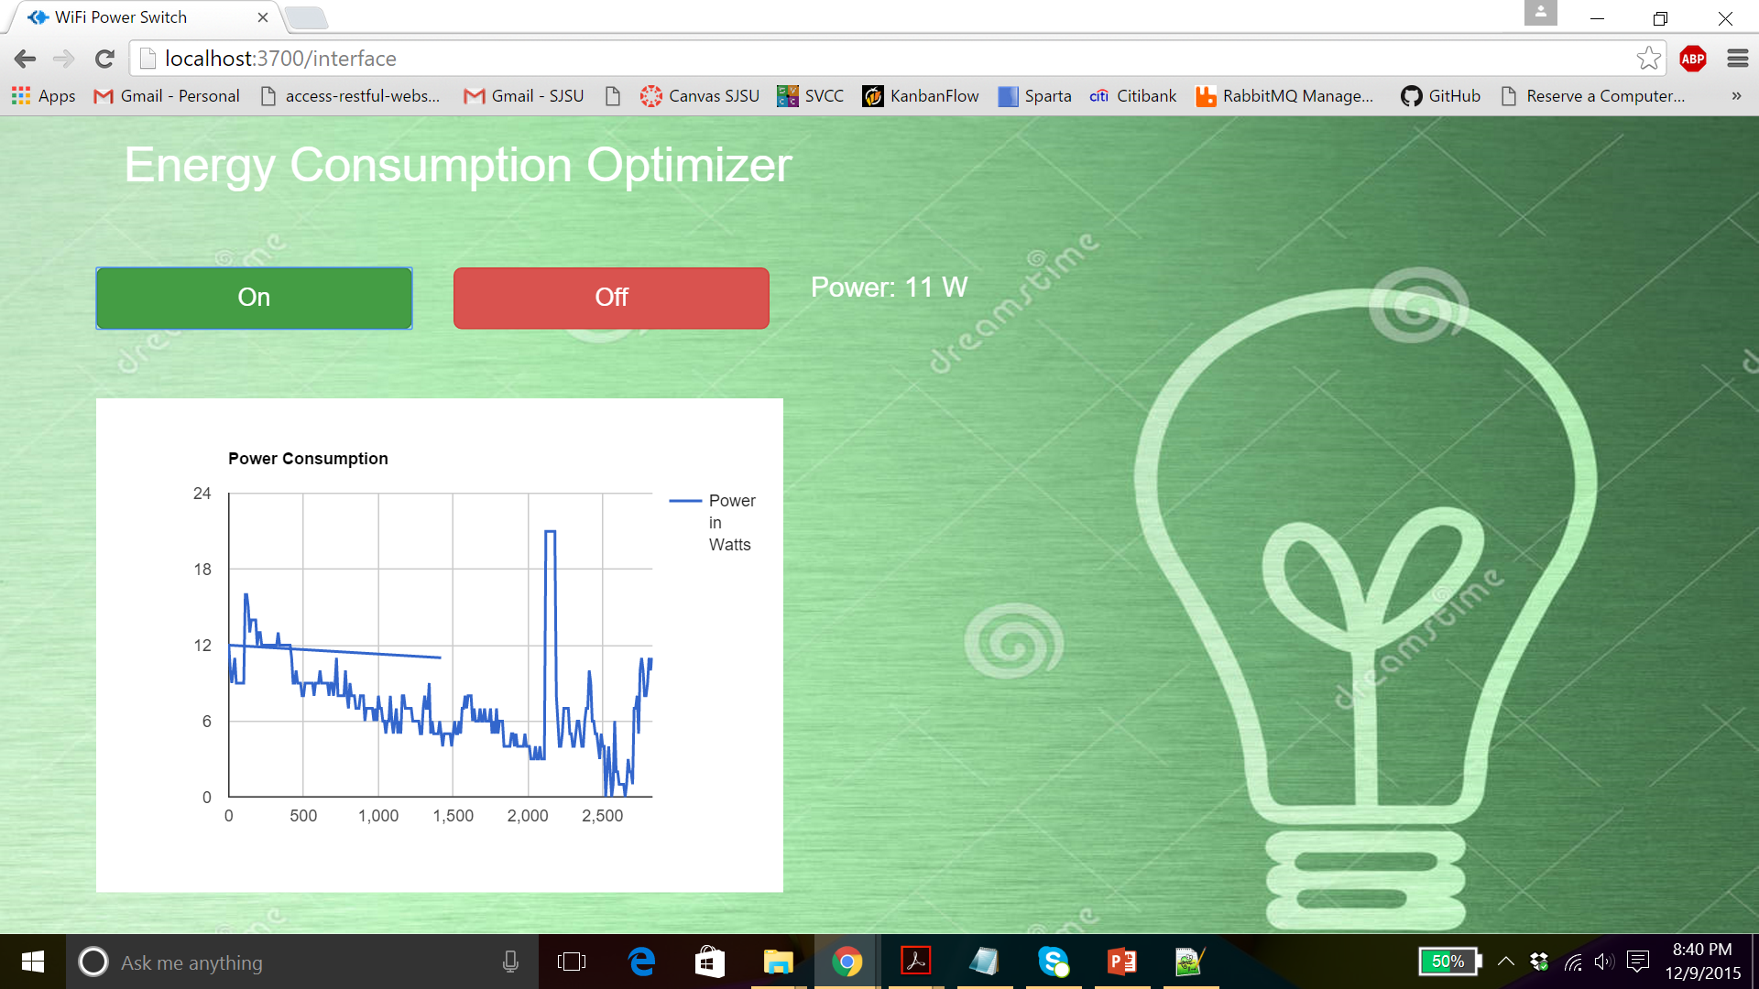
Real Time Power Consumption Graphs

